Slide 1


Presentation of TREE TRAVERSING

Slide 2
Three Tree Traversing ways is 1.Preorder 2.Inorde 3.Postorder

Slide 3
1.Preorder: 1. Process the root R. 2. Traverse the left subtree of R in preorder. 3.Traverse the right subtree of R in preorder.

Slide 4
2.Inorder 1.Traverse the left subtree of R in inorder. 2.Process the root R. 3.Traverse the right subtree R in inorder.

Slide 5
3.Postorder 1.Traverse the left subtree of R in postorder. 2.Traverse the right subtree of R in postoder. 3.Process the root R.

Slide 6
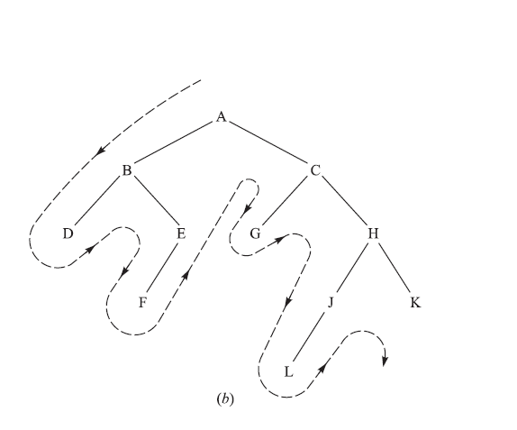
1.Peorder:ABDEFGHJLK 2.Inorder:DBFEAGCLJHK 3.Postorder:DFEBGLJKHCA

Slide 7
THE END

